Slide 1
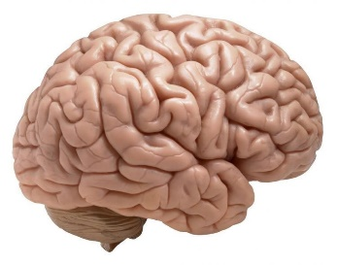
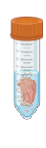

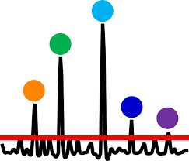
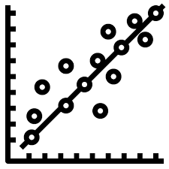
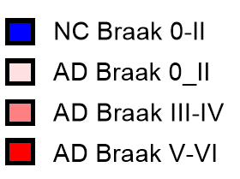
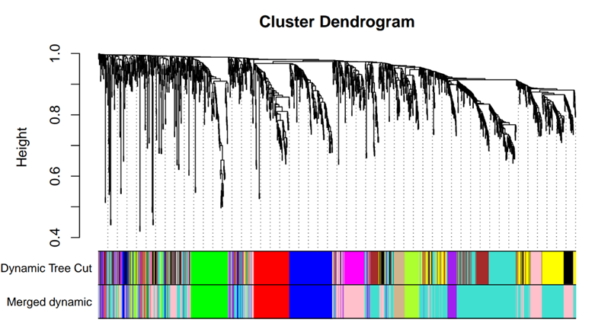
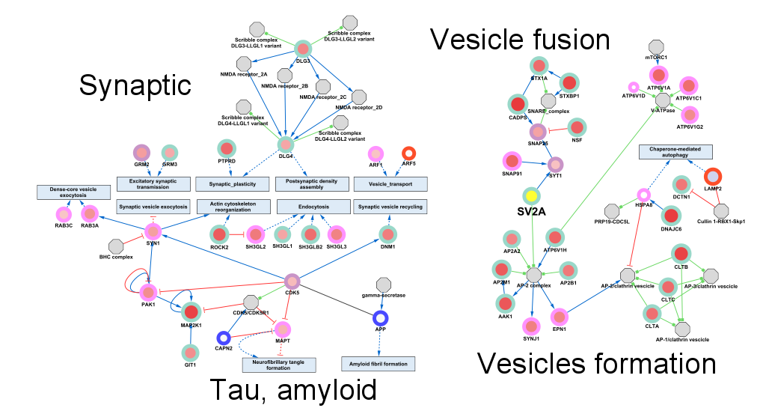
Figure 5 : 22 11 2024
Fresh Frozen
Post-mortem
human brain
BioFluid Extraction
BD-EV Extraction
Mass
Spectrometry
Linear
correlation
WGCNA
PF
Protein Protein for synatiic module with code of correlation with SV2A level
M4
M6
M5
M1
M8
M7
a
M3
M2
Endoplasmic
Reticulum
Axonal Transport
Synaptic Vesicle
Extracellular vesicle signaling
Proteasome
Cell Signaling
Ribosome
Mitochondria

Slide 2

SV2A in ISF’s brain derived EV
a
BrainD-EV extraction
Mass spectrometry
BioFluid extraction
Fresh Frozen
Post-mortem
human brain
(NC and AD)
PF
b
c
d
e
f
g
h
i
j
k

Slide 3

a
BrainD-EV extraction
Mass spectrometry
BioFluid extraction
Fresh Frozen
Post-mortem
human brain
(NC and AD)
PF

Slide 4
M4
M6
M5
M1
M8
M7
M2
M3
Endoplasmic Reticulum
Extracellular vesicle signaling
Axonal Transport
Proteasome
Ribosome
Mitochondria
Cell Signaling
Synaptic Vesicle

Slide 6
SV2A in ISF’s brain derived EV
a
BrainD-EV extraction
Mass spectrometry
BioFluid extraction
Fresh Frozen
Post-mortem
human brain
(NC and AD)
PF
b
c
d
e
f
g
h
i
j
k

Slide 7
a
BrainD-EV extraction
Mass spectrometry
BioFluid extraction
Fresh Frozen
Post-mortem
human brain
(NC and AD)
PF

Slide 8
M4
M6
M5
M1
M8
M7
M2
M3
Endoplasmic Reticulum
Extracellular vesicle signaling
Axonal Transport
Proteasome
Ribosome
Mitochondria
Cell Signaling
Synaptic Vesicle

